Slide 1
REVEALING AND CLASSIFICATION OF DEEP FAKE IMAGES WITH VIDEOS USING CUSTOMIZED DEEP LEARNING MODELS
PAPER ID: ICCET241406
Presented by:
PRAVEEN KUMAR K
School of Computer Applications
Karpagam College of Engineering
Coimbatore, Tamilnadu
Guided by:
Mr. RAMPRASHATH R ASST.PROF., MCA, M.PHIL., MBA., NET.
School of Computer Applications
Karpagam College of Engineering
Coimbatore, Tamilnadu

Slide 2
ABSTRACT:
Deep fakes are becoming more common; they include editing previously published films and photos to produce content that appears authentic but is wholly fake. The development process has been considerably expedited by the widespread availability of deep learning techniques, such as autoencoders, Generative Adversarial Networks (GANs), and user-friendly software. These sophisticated algorithms adeptly fuse and modify visual and audio elements, facilitating the production of content that closely mimics genuine footage, even for those without specialized knowledge. The malicious manipulation of images and videos poses significant security and societal concerns. With an emphasis on facial alteration, the goal of this research is to create a deep learning perfect for the detection and classification of deepfake images and videos. The dataset used for the project is either Face Forensics++, Celeb-DF, or the Deepfake Detection Challenge Dataset (DFDC), available on Kaggle, consisting of real and deepfake images and videos. By utilising Recurrent and Convolutional Neural Networks, we have made development in DF detection. Commencing with preprocessing the data, extracting frames from the videos, and separating the dataset into training and validation sets. For the detection and classification of deepfake images and videos, OpenCV, and Face Recognition for facial detection, Convolutional neural networks (CNNs) are used by the system to extract features at the frame level. A recurrent neural network is trained using these features (RNN).

Slide 3
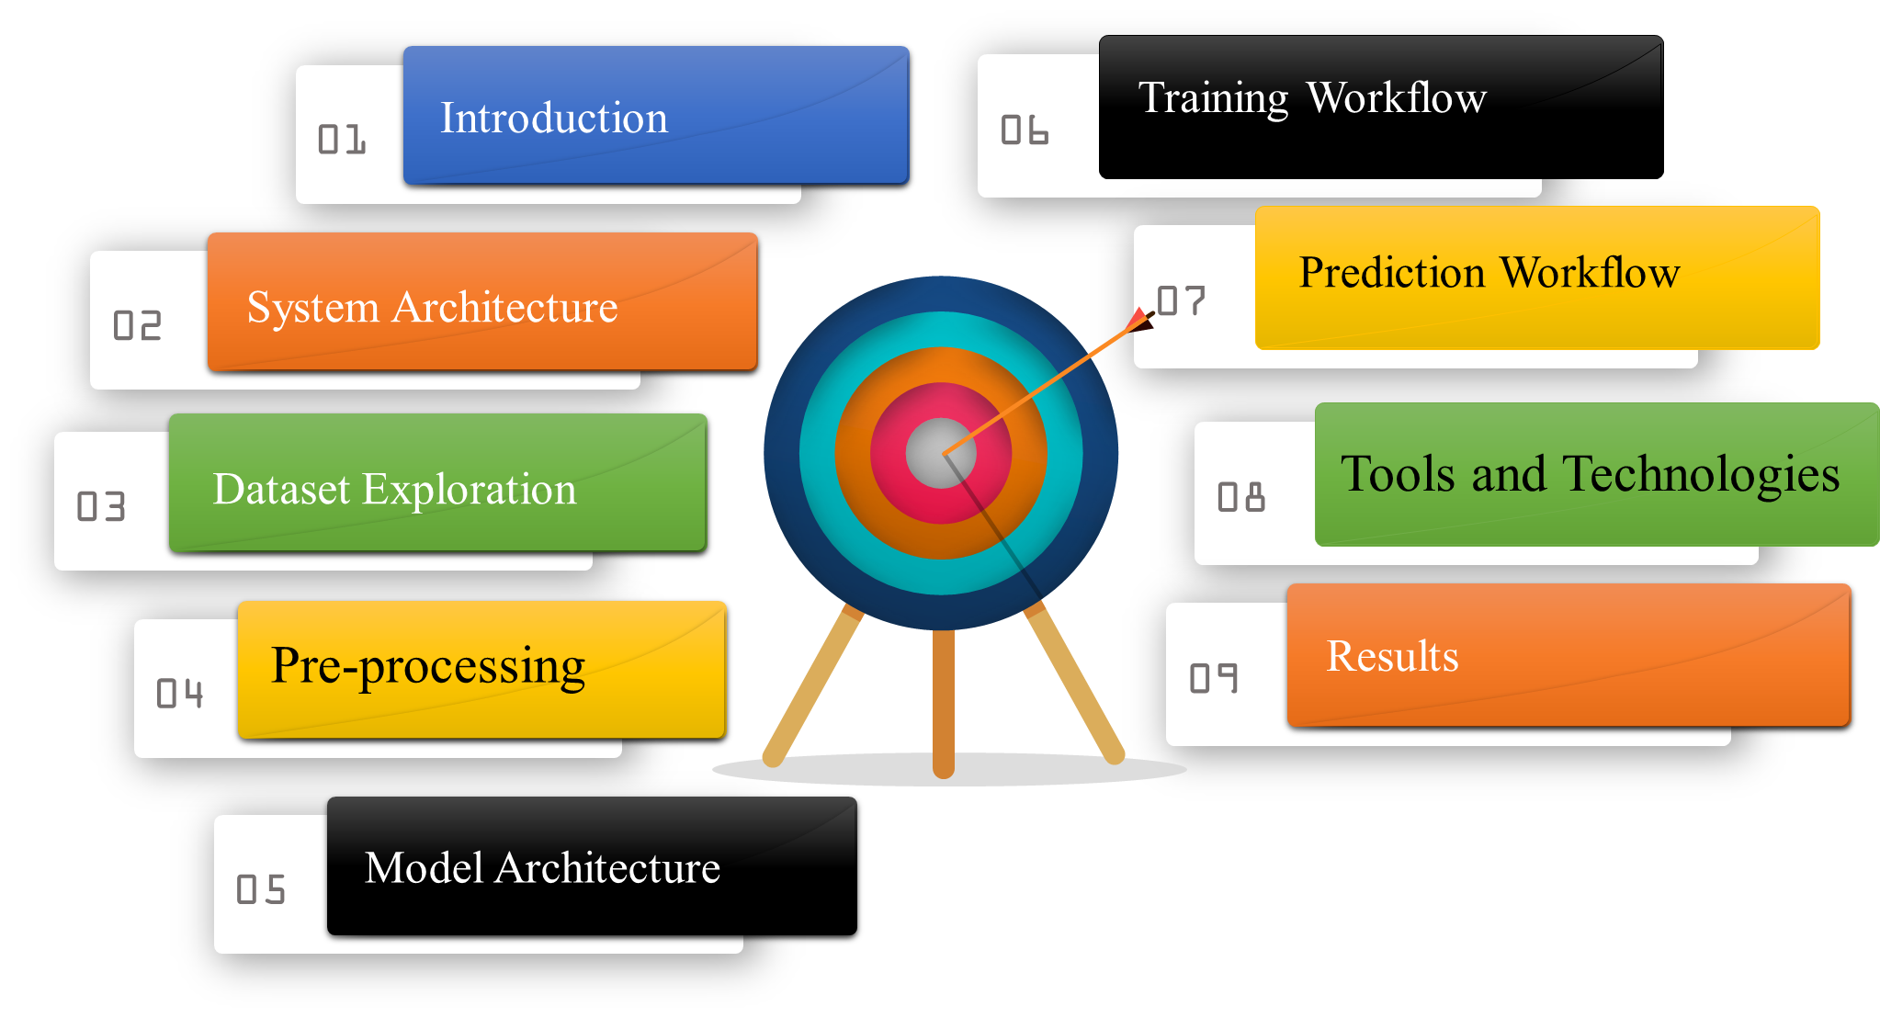

Slide 4
INTRODUCTION:
Smartphones with good cameras and fast internet have made it easy to create and share videos online. At the same time, new computer technology has allowed for the creation of deepfakes—videos that are altered using advanced techniques like Generative Adversarial Networks (GANs) and autoencoders. These deepfakes can spread false information on social media and cause serious problems for society. To address this issue, our project aims to develop a strong computer program that can find and sort deepfake videos and pictures, focusing on changes to people's faces. We'll use different sets of data that include both real and fake media to train our program. Our method looks closely at how deepfakes are made, particularly focusing on the way GANs work. By analyzing small differences between real and fake images, our program can spot deepfakes. We'll also use techniques like adjusting learning rates and stopping early to improve our program's accuracy. Our goal is to stop the spread of deepfake media and protect the truth online.

Slide 5
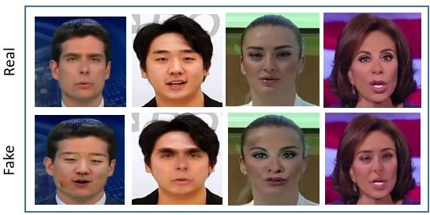
Samples from the FaceForensics++ dataset depicting both unaltered and manipulated facial images.

Slide 6
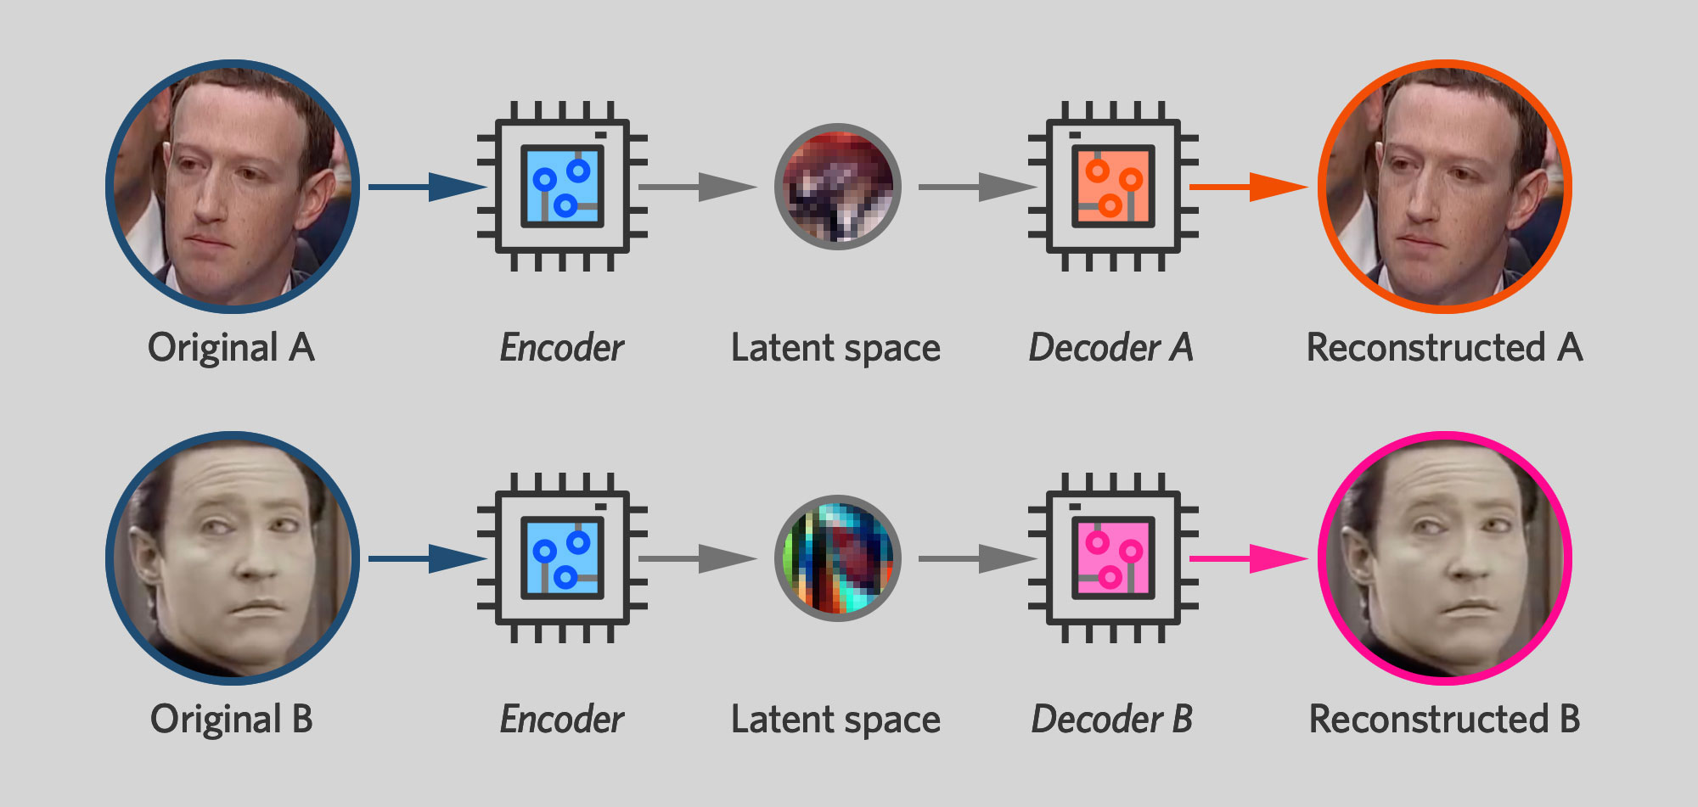
How Deep Fakes Are Created ?
Tools for deep fake creation.
Faceswap
Faceit
DeepFaceLab
DeepfakeCapsuleGAN
Large resolution facemasked

Slide 7
EXISTING SYSTEM:
Deepfake videos are causing big problems for important values like democracy and fairness. People are working hard to find ways to stop them. One method uses a special computer program called a Convolutional Neural Network (CNN) to spot fake parts of faces in videos. Another idea focuses on looking for eye blinking, which is hard to fake in videos made by computers. Some researchers are using capsule networks to find fake images and videos in different situations. They're trying to improve their methods to work well in real-life situations without mistakes. There are also methods that use biological signals to detect fake videos, but they have some challenges to overcome.
Disadvantages:
High computational requirements, demanding powerful hardware for training.
Vulnerable to adversarial attacks, compromising model robustness and reliability.
Limited interpretability, making it challenging to understand model decisions.

Slide 8
PROPOSED SYSTEM:
Many tools make deepfake (DF) content, but reliable detection tools are rare. This new approach aims to detect DF in both images and videos, which is a big step in stopping fake content online. It plans to make a simple website where people can upload images and videos to check if they're fake or real. If successful, it could become a browser add-on for finding deepfakes automatically. Big apps like Facebook and WhatsApp might even use this technology to help their users. We want to see if people like using it and if it works well in terms of security, accuracy, reliability, and ease of use. The focus is on three types of deepfakes: replacement, retrenchment, and interpersonal.
Advantages:
New techniques effectively detect deepfakes in both images and videos.
Provides comprehensive coverage against various forms of digital manipulation.
Strengthens defense against evolving deepfake methods in multimedia content.
Offers versatility in identifying deceptive media across different online platforms.

Slide 9
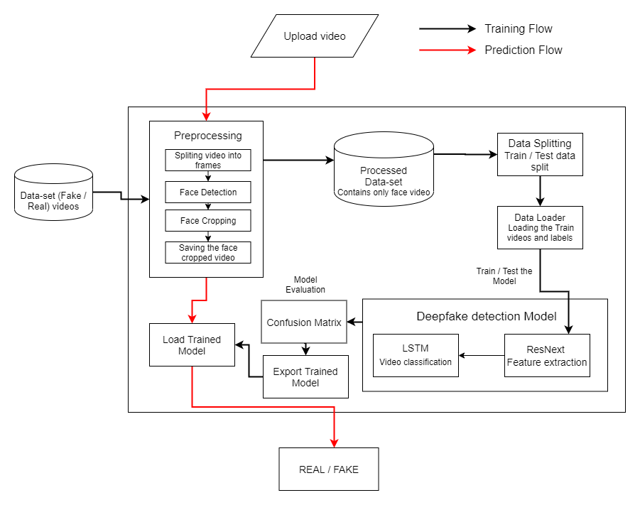
SYSTEM ARCHITECTURE:

Slide 10
Fake Image Detection CNN layers
For detecting fake images, our model employs multiple CNN layers. These layers are specifically designed to analyze image data and extract intricate features indicative of manipulation or authenticity. The above image shows the structure of CNN layers for Fake Image Detection.

Slide 11
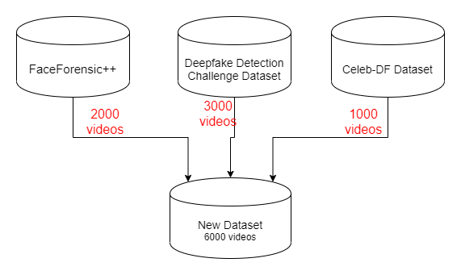

DATA-SET EXPLORATION

Slide 12
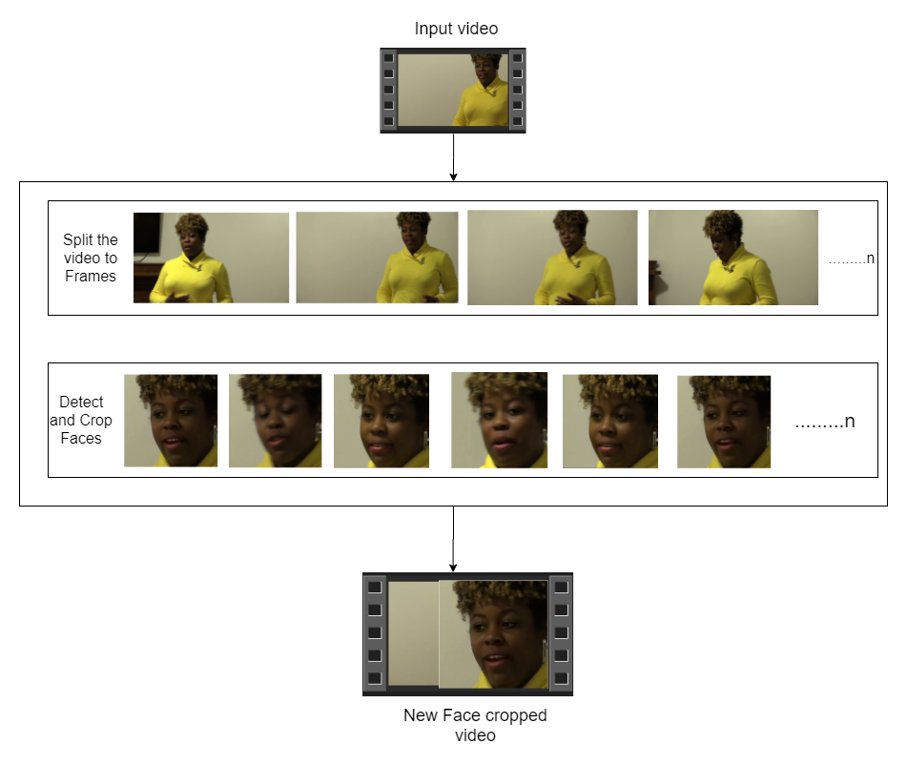

PRE-PROCESSING:
Video detection, on the other hand, follows a different approach. We first preprocess the videos using ResNext CNN, which LSTM network is used to carry out the real detection. This combination allows for a comprehensive analysis of temporal patterns within the videos, aiding in the accurate identification of deepfake content.
SPLIT VIDEO INTO FRAMES
FACE DETECTION
CROPING FACE
CREATING NEW FACE CROPPED VIDEO
SAVING THE FACE CROPPED VIDEO

Slide 13
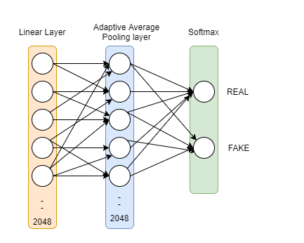
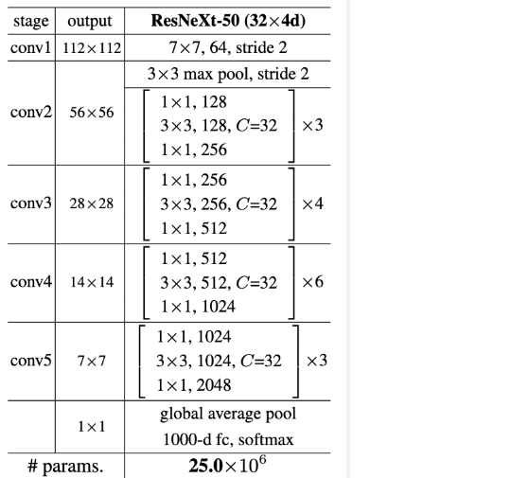

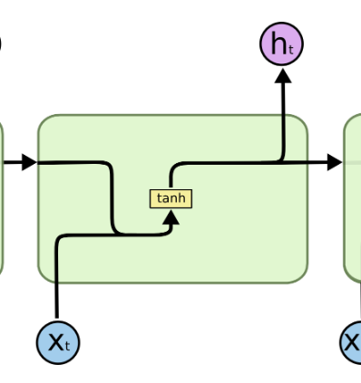
Model Architecture
ResNext-50
Sequential Layer
1 LSTM layer with 2048 shape input vector and 2048 latent features along with 0.4
chance of dropout and ReLU Activation function

Slide 14
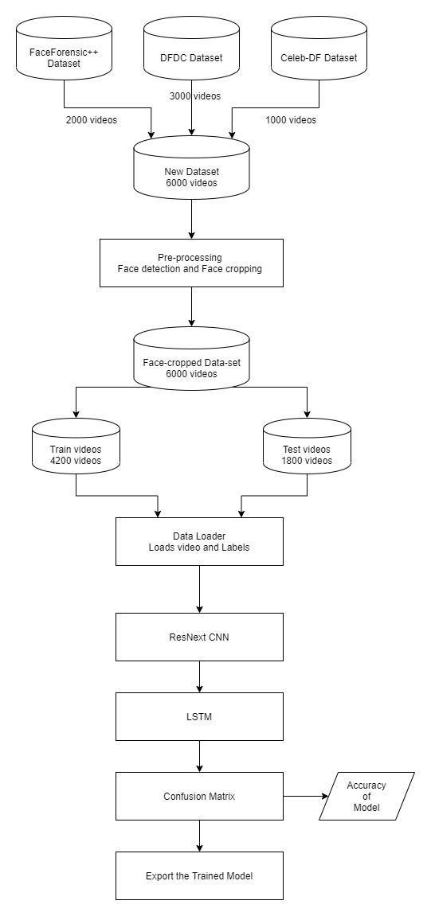
TRAINING WORKFLOW:
To detect deepfake videos, we use a two-step process. First, we prepare the videos using a special type of computer program called ResNext CNN. This program helps us get the videos ready for analysis. Then, we use another program called LSTM network to actually detect whether the videos are real or fake. This method helps us look closely at how things change over time in the videos, which is important for spotting deepfakes. By combining these two programs, we can better understand the patterns in the videos and accurately identify any fake content.

Slide 15
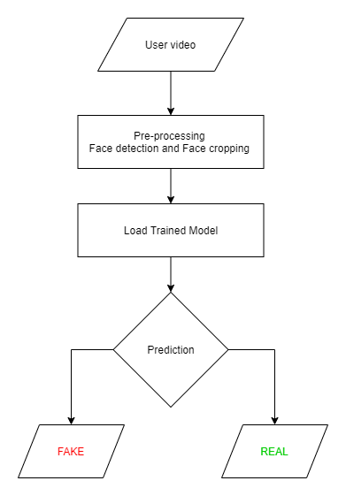
PREDICTION WORKFLOW:
A fresh video is given to the trained algorithm for forecasting. In addition, the format of the learnt model is imported by preprocessing a new video. The faces in the divided video are cropped once it has been divided into frames, and instead of being kept locally, the cropped frames are transmitted directly to the trained model for detection. Figure 5 shows the prediction procedure.

Slide 16
TOOLS AND TECHNOLOGIES
HARDWARE REQUIREMENTS:
SOFTWARE REQUIREMENTS:
Operating System: Compatible with Windows and Linux.
RAM: 16GB (recommended) or 8GB (minimum requirement)
Hard Disk: 100GB working space (recommended) or 50GB (minimum requirement)
GPU: NVIDIA CUDA-enabled GPU (recommended for improved deep learning performance)
Languages: Python 3.6 or higher
IDE: Python 3.8.0 , vscode
Framework: Flask
Technology: Advanced programming using Python with GPU support for deep learning (NVIDIA CUDA)

Slide 17
RESULTS:
Model | Acc(train) | Acc(valid) | Acc(test)
Configuration 1 | 83.64 | 83.64 | 83.44
Configuration 2 | 89.69 | 87.84 | 86.94
Configuration 3 | 92.99 | 90.34 | 90.08
Configuration 4 | 92.05 | 89.67 | 91.10

Slide 18
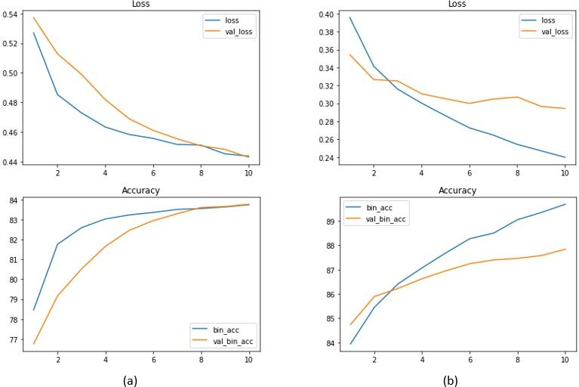
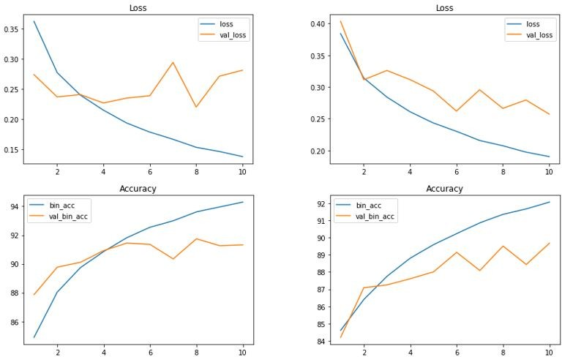
Training History of Configurations 3 (a) and 4 (b)
Training History of Configurations 1 (a) and 2 (b)

Slide 19
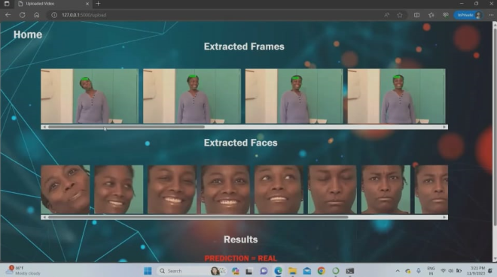

Slide 20
CONCLUSION:
Our project introduces a neural network approach to differentiate between real and fake images and videos, along with the confidence of the proposed model. We were inspired by how deepfakes are made using GANs with the assistance of Autoencoders. Our method analyzes each frame of the content using ResNext CNN for images and RNN with LSTM for videos. By considering specific parameters, our model accurately identifies whether the content is authentic or manipulated. We expect our method to perform well when applied to real-world data in real-time scenarios.

Slide 21


